Slide 1
RNN ENFORCED COMPUTERIZED SYNOPSIS BUILDER
Team : -
Sweta Gupta - 61
Yash Jobalia - 63
Isheet Shetty - 72
Project Guide: Prof. Anagha Patil

Slide 2



Team Members
Sweta Gupta 61
Yash Jobalia 63
Isheet Shetty 72

Slide 3
Introduction
When we generally open news sites, we do not read every news article. We typically glance at the short news summary and then read more details if interested. Similarly, when we read a long paragraph, we generally list down the important points or important phrases in our minds, they are a form of short summaries of the passage. As we can see that summarization is an important aspect in our day to day lives, it saves our time and efforts. Now imagine what if these short summaries were generated automatically for you for the given texts. Reducing the number of text or generating short summaries with a computer program that retains the most important points of the original text would be a great tool to come in handy.

Slide 4
Motivation
In today’s world, time is precious and equivalent to money, so no one has the time to read long reports.
Hence our summarizer helps us to save that precious time by creating short summaries of long texts and chapters .
Our project can summarize audios and text into short summaries in order to give brief ideas of the important topics.

Slide 5
Problem Statement
Today, our world is parachuted by the gathering and dissemination of huge amount of data. With such a big amount of data circulating in the digital space, there is a need to develop machine learning algorithms that can automatically shorten longer texts and deliver accurate summaries that can fluently pass the intended messages. So, an automated summary is an effective way to solve this problem. Hence, to produce summary without any human help while preserving the meaning of the original text document, we can use a ML model with bi-directional RNN with LSTM in encoding and attention model in decoding layer by applying Sequence-To-Sequence model .

Slide 6
Literature Review
6

Slide 7
Analyzing Fuzzy Based Approach for Extractive Text Summarization
Abstractive Method of Text Summarization with Sequence to Sequence RNN ’s
Extractive Text Summarization using Sentence Ranking
1
3
5
2
4
Extractive Text Summarization by Feature-Based Sentence Extraction using Rule-Based concept
NLP based Latent Semantic Analysis for Legal Text Summarization

Slide 8
Extractive Text Summarization using Sentence Ranking
Dataset : 5 documents with 20 sentences
Moto : Summarize documents using Extractive Text Summarization.
Approach : Extractive Text Summarization using Sentence Ranking [1]
Implementation :
Firstly, the file which is given as input is tokenized.
The stop words are removed from the text.
The words which are remained are considered as a keyword.
After completing this preprocessing step we are calculating frequency.
Now weighted frequency of the word is calculated.
Finally, summarizer will extract the high weighted frequency sentences and the extracted sentences are converted into audio form.
DRAWBACK : Accuracy level is low.
FUTURE SCOPE : Multiple documents of similar topic can also be summarized.
Notes:
***** SENTENCE RANKING *****
Dataset : 5 documents with 20 sentences
Moto : Summarize documents using Extractive Text Summarization.
Approach : Extractive Text Summarization using Sentence Ranking
Implementation : They are taking input as text file (.txt). Firstly, the file which is given as input is tokenized in order to get tokens of the terms. The stop words are removed from the text after tokenization. The words which are remained are considered as a keyword. The key words are taken as an input for that we are attaching a part of tag to each keyword. After completing this pre-processing step, we are calculating frequency of each keyword like how frequently that key word has occurred, from this maximum frequency of the keyword is taken. Now weighted frequency of the word is calculated by dividing frequency of the keywords by maximum frequency of the key words. In this step they are calculating the sum of weighted frequencies. Finally, summarizer will extract the high weighted frequency sentences and the extracted sentences are converted into audio form.
Drawback : Accuracy level is low.
Future Scope : Multiple documents of similar topic can also be summarized.
After completing the pre-processing step we calculate frequency of each keyword like how frequently that key word has occurred, from that maximum frequency of the keyword is taken. Then weighted frequency of the word is calculated by dividing frequency of the keywords by maximum frequency of the key words. In this step, we calculate the sum of weighted frequencies. Finally, summarizer will extract the high weighted frequency sentences and the extracted sentences are converted into audio form.

Slide 9
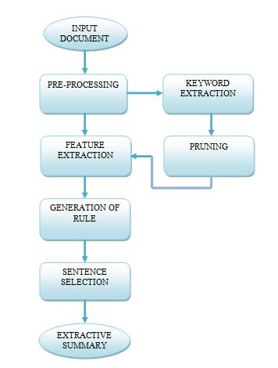
Extractive Text Summarization by Feature-Based Sentence Extraction Using Rule-Based Concept
Dataset : Document Understanding Conferences (DUC) 2002 dataset.
Work : Summarize documents using Extractive Text Summarization.
Approach : Extractive Text Summarization using Rule-Based Summarizer [2]
Implementation :
Pre-processing is the most primary step.
Then, the next step is keyword extraction.
Then comes the pruning, a threshold is defined.
Once threshold is calculated, all terms with tf less than the threshold value are pruned off from the document.
Seven features are calculated for each sentence and each feature is given a value from 0 to 1 after normalization.
All sentences are sorted in ascending order based on their scores. Final extractive summary of the document will be displayed.
DRAWBACK : Accuracy level is low.
FUTURE SCOPE : Multiple documents of similar topic can also be summarized.
Notes:
***** Rule-Based Concept *****
Dataset : Document Understanding Conferences (DUC) 2002 dataset
Moto : Summarize documents using Extractive Text Summarization.
Approach : Extractive Text Summarization using Rule-Based Summarizer
Implementation : The main focus of this paper is to summarize a single document and create its extractive summary. Pre-processing is the most primary step in any summarization method. Pre-processing methods applied are tokenization, stop word removal and stemming. Then, the next step is keyword extraction. In keyword extraction phase, frequency count of each word or a term in a document is calculated in order to find out its importance. Then, in pruning, a threshold is defined. This value is calculated, by summing the term with lowest frequency and the term with the largest frequency thus taking their mean. Once threshold is calculated, all terms with tf less than the threshold value are pruned off from the document. After pre-processing step, each sentence of document is represented as attribute vector of features. Seven features are calculated for each sentence and each feature is given a value from 0 to 1 after normalization. Features considered are Sentence Position, Title Feature, Numerical Value, Keyword Weight, Proper Noun, Sentence To Sentence Similarity, Sentence Length. All sentences are sorted in ascending order based on their scores. Final extractive summary of the document will be displayed.
Drawback : Accuracy level is low.
Future Scope : Multiple documents of similar topic can also be summarized.

Slide 10
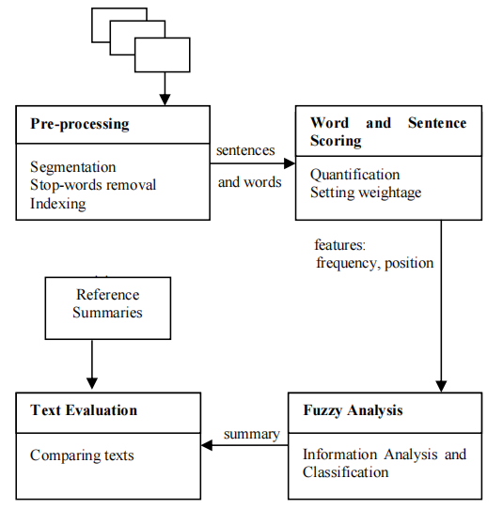
Analyzing Fuzzy Based Approach for Extractive Text Summarization
Dataset : BBC news summary dataset.
Work : summarise news reports using fuzzy logic.
Approach : extractive text summarisation using fuzzy logic and triangular method [3]
Implementation :
First the data set is pre processed.
Then calculate frequency and position this is done by using hashmap.
The last step is fuzzy analysis where the calculated values are used to find the mean for that sentence and are fed to the triangular membership function which give values between 0 and 1 to each sentence and the fuzzy rule is applied.
Finally they ROUGE score is given to each and every summary to be compared efficiently.
DRAWBACK :There is no criteria where all the 3 recall precision and f member are greater than using bell membership function .
FUTURE SCOPE : The value of these can be enhanced more by using abstractive method.

Slide 11
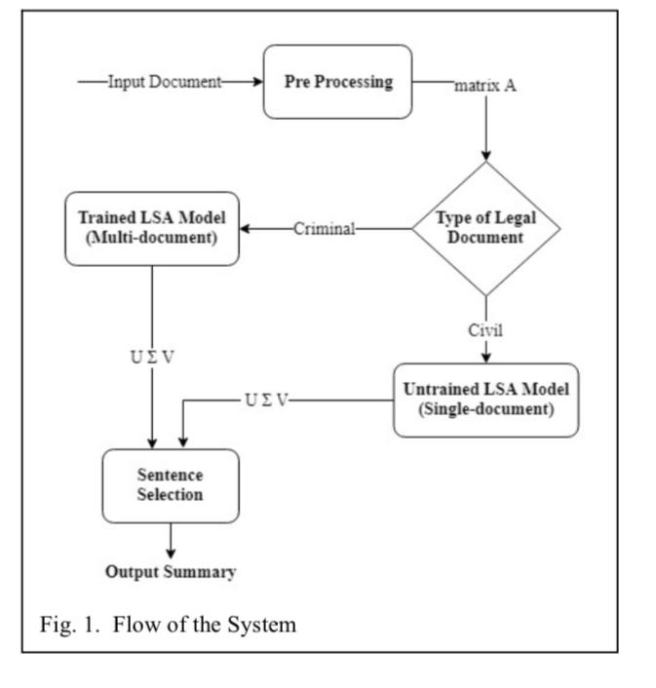
NLP based Latent Semantic Analysis for Legal Text Summarization
Dataset : They used data set from supreme high and district court cases
Work : summarise legal documents and judgements passed in courts
Approach : Latent semantic analysis i.e creating short summaries on basis of similar words [4]
Implementation :
They use 2 approaches depending on the type of case if it is a criminal case single document untrained approach is used and for civil case multi-document trained approach is used.
Firstly pre-process the data.
Then passing it through the model depending on the type finally judgement passed and then final summary output is generated.
DRAWBACK : Extractive and not completely effective.
FUTURE SCOPE : Aims to improve summary generated not only on the basis of similar words but also similar concepts.

Slide 12
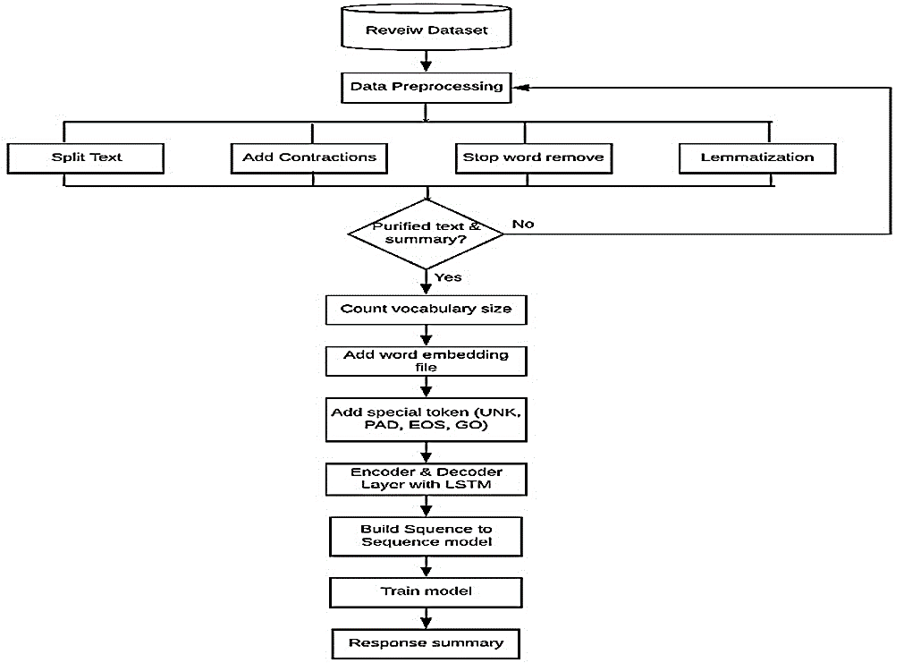
Abstractive Method of Text Summarization with Sequence to Sequence RNN
Process :
Dataset : Amazon fine food reviews dataset
Work : It is an automated abstractive text summarizer to generate summary easily by machine.
Approach: Sequence to Sequence model to generate short summary using bi directional RNN with LSTM in the encoding layer and attention model in decoding layer [5]
Model Trainer : Tensorflow CPU version

Slide 13
Implementation :
Data Collection : A good dataset
Data Preprocessing : Converted all the texts to lowercase and then split all of the texts and addition of contractions and removed unnecessary component and stop words from the text and lemmatized words.
Model :
Longest Short-Term memory (LSTM) will helpful for text modeling.
The encoder takes the input sequence and decoder show or predicts the output sequence.
Used a neural network which contains 2 layers RNN ’s encoder and decoder.
Encoder contains a fixed length of a sentence and decoder contains the sequence of output. Used tensorflow 12.1.0 seq to seq model.
Their output was positive which gave short summary of a few words.
DRAWBACK : A most important limitation is machine provide a correct summary only short text.
FUTURE SCOPE : In future, our main purpose is generating a model which learn any length and generate correct summary which has no fixed length.

Slide 14
Comparative Study
Paper | [1] | [2] | [3] | [4] | [5]
Types Of Summarization | Extractive Summarization | Extractive Summarization | Extractive Summarization | Extractive Summarization | Abstractive Summarization
Method Used | Sentence Rating Method | Fuzzy Logic | Rule-Based Method | Semantic Analysis | Sequence To Sequence bi-directional RNN with LSTM
Training Model | Sentence Ranking with Text Rank | Fuzzy Analysis with Triangular Membership Function | Rule-Based Summarizer | Single Document Untrained Approach For Criminal Multi Document Trained Approach For Civil | Tensorflow 12.1.0
Dataset | 5 Documents with 20 sentences | BBC News | DUC 2002 | District, High and Supreme Court | Amazon Fine Food Review
Accuracy | Low | Low | Low | Low | High

Slide 15
Project Implementation Flow
Input
User can select any one of the methods for input: Audio or Document
Using Python Speech Recognition/ Google Speech To Text API
Document
Text Extraction
Audio
Text
Additional Feature
Further summary can be converted to speech
Summarized Text
15

Slide 16
Implementation

Slide 17
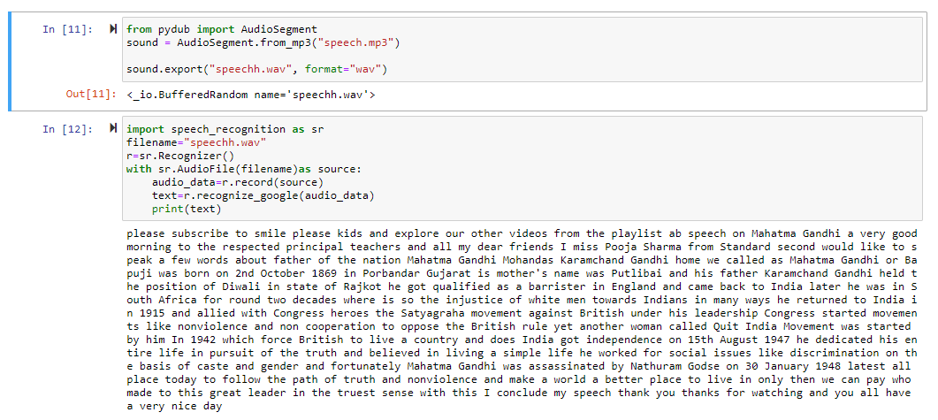
Speech To Text

Slide 18
Methods Implemented
Xsum(A), large(E), Reddit tifu(A)
Gensim Approach
Depends on User Input(E)
Depends on User Input(E)
Transformer Model Approach (Pegasus)
Rule Based Approach

Slide 19
Text Used to Test
The movie starts off with a man in a coat and hat trying to defuse a bomb. He gets distracted by a gunshot and before the bomb can be safely defused, it blows up burning the face of the man in the coat and hat. Another person walks up to burnt man and helps him reach out to a violin case. The burnt man uses the violin box and disappears. There are three people in this scene. The man trying to defuse the bomb, this is John. The man who fires at John, this is the Fizzle bomber and the man who helps John with the violin case, this is the Barkeep. The point to be noted here is that they are all the same person from 3 different times. Don’t give it too much thought right now. Read on further.Burnt face man, John, goes back to a future time – 1992, and gets his face grafted. Since his face is completely destroyed, they give him a new face. This is the face that we will refer to as Barkeep. John/Barkeep has been trying to hunt down a chain bomber that they call the Fizzle bomber. He has been trying to stop a major New York event in 1975 which kills over 10,000 people, but has been unsuccessful so far. He is a temporal agent of a mysterious Temporal Bureau who have the ability to travel through time.Barkeep has one final mission he has to embark on now. For which he travels back to 1970 and plays the role of a barkeep. His younger self, John from 1970, arrives at the bar. They start talking. John reveals that he is the author – Unmarried Mother. John starts telling the story of his life where he was born a girl and was called Jane. Jane was a baby abandoned at an orphanage in 1945. Jane never ends up getting adopted and she eventually tries to join the Space Corps program headed by one Mr. Robertson. Jane gets rejected from the program because something in her physiology is “odd”. But they don’t tell her that when they disqualify her. They simply pin the disqualification on the fight Jane has with another girl in the Corp. This detail comes as a flashback later on in the movie.Jane gives up and attends night school where she bumps into a stranger. She falls in love with him, but the stranger disappears on Jane one day, leaving her waiting on a bench. We will get back to who this stranger is in a bit. Jane realizes that she is pregnant. She delivers a baby successfully but the doctor tells her that Jane has an “odd” physiology – she has fully formed male and female organs. Complications in delivery result in the doctors only being able to save the male organs. Jane will need to change to a man as a result. Soon after this, her baby gets stolen. Jane becomes John over time.John completes telling this story to the Barkeep. However, the Barkeep knows all of this. It is his own life’s story after all. He doesn’t reveal that yet. Barkeep tells John that he knows the location of the “stranger” who ruined Jane’s life. Barkeep promises that he will give John the opportunity of revenge, of killing that stranger free of any consequences. John and Barkeep use the violin box to travel back in time to the point where Jane was attending night school. John equips himself with a gun and goes looking for the stranger but bumps into Jane. John soon realizes that he is that “stranger”. He falls in love with Jane and has sex with her.Yes, folks, the male self goes back in time when he was female and has sex with him/herself. Bizarre, we now know another one of those things that is apparently possible in this universe of the film. Talk about self-sufficient! Hang on, there is more to come.While all of this is happening, Barkeep quietly slips out and goes forward to 1970 – to the event of the bomb defusal, the first scene of the movie. Barkeep arrives to notice the Fizzle bomber placing the bomb; they get into a gunfight, then into a fist fight. Barkeep gets his ass handed to him and faints. He wakes up just in time to see John’s face getting burnt trying to defuse the bomb. Barkeep helps John with the violin box. The Fizzle bomber escapes.Barkeep heads to the time when Jane has given birth. Mr. Robertson joins him there. It is shown that he too has a little violin box of his own and can travel through time, he seems to head the Temporal Bureau. Barkeep steals Jane’s baby and travels back to 1945 with the baby. He abandons the baby at the orphanage.Yep, not only does the male from a future time has sex with his past girl self, the baby born as a result is the origin of him/herself too. Messed up right? That is truly self-sufficient indeed! This also explains why the baby would grow with both sex organs. Ladies and gentlemen, that’s your predestination and bootstrap paradox right there. Jane/John is a self-created entity because the “he” from a future time has sex with the “she” from a past time.Once Barkeep leaves the baby, he returns to the time John and Jane are still together. He signals for John, John leaves Jane waiting on the bench. Barkeep tells John that they need to leave this time and travel forward. At this point Barkeep tells John that he too is John from a future time with a different face – however, in the movie, this portion is disclosed only in the end. Barkeep and John travel forward to 1985. Barkeep meets Mr. Robertson and leaves John to recover there and travels back to 1975 for retirement. By now Barkeep has made an audio recording for John to hear and follow. Barkeep heads off to 1975 (just before the New York event date).John recovers from the shock of the truth and uses the tape left to him by Barkeep to prep to become a temporal agent. Seven years later, in 1992, John jumps back to 1970 wearing a coat and a hat to defuse a bomb set by the Fizzle bomber. John gets into a gunfight with the Fizzle bomber and ends up getting distracted. The bomb goes off burning John’s face.There you have it. That explains why in the first scene of the movie you have 3 people – John, Barkeep and Fizzle bomber who are the same person from 3 different times.

Slide 20
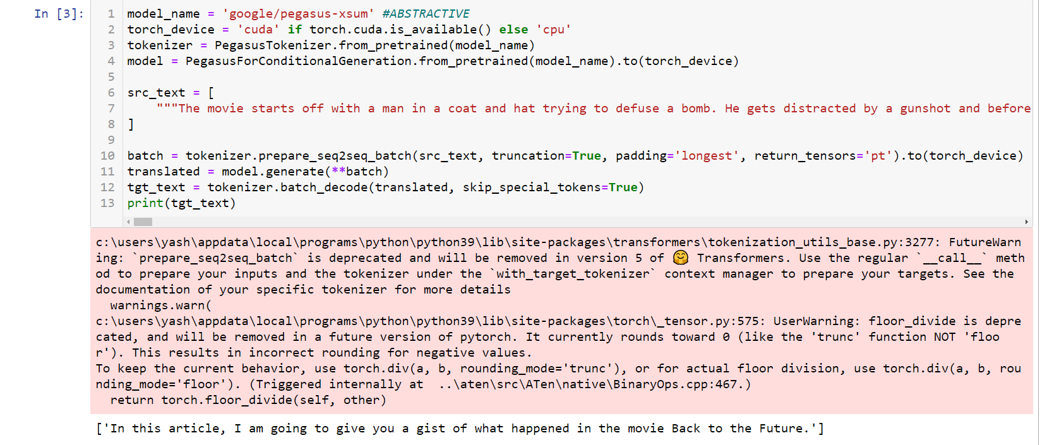
Pegasus (xsum)_Abstractive This model gives very short abstractive summary of the text passage.

Slide 21
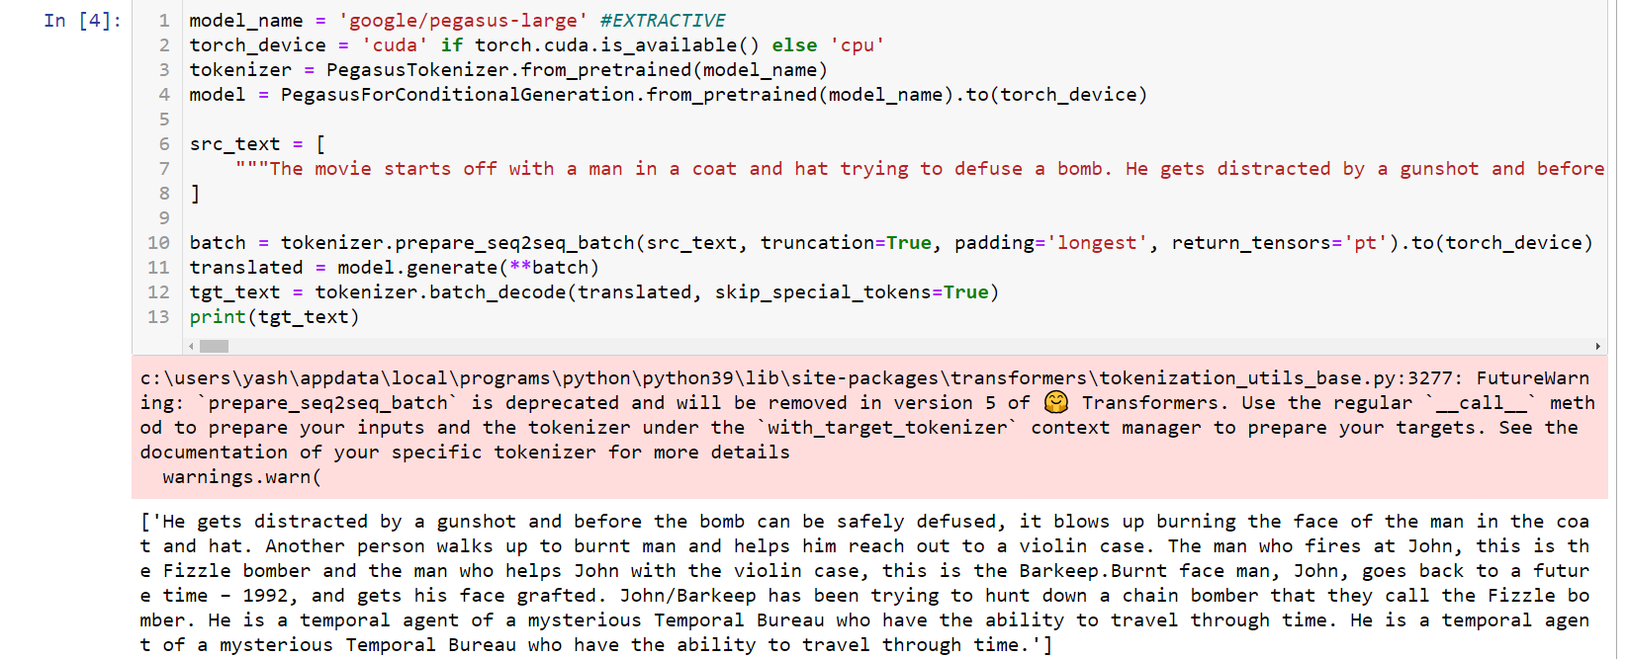
Pegasus (Large)_Extractive
This model gives brief abstractive summary of the text passage.

Slide 22
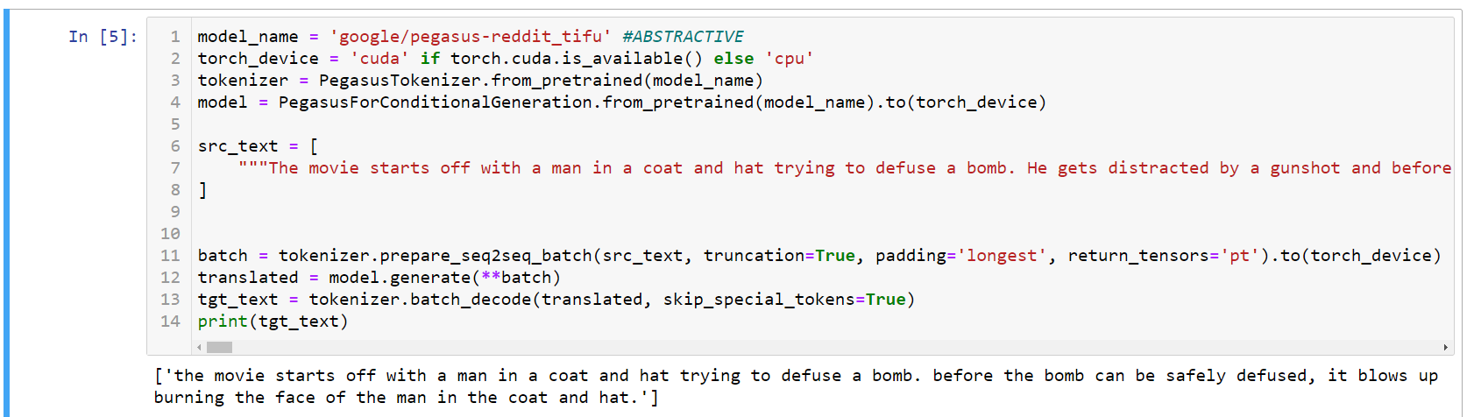
Pegasus (Reddit-tifu)_Abstractive
This model gives concise abstractive summary of the text passage.

Slide 23
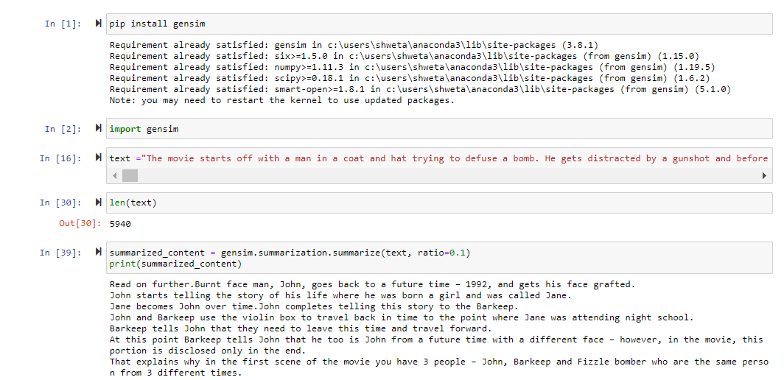
Gensim Approach - Extractive
Extracts one or more important sentences and also can extract on the basis of keywords.

Slide 24
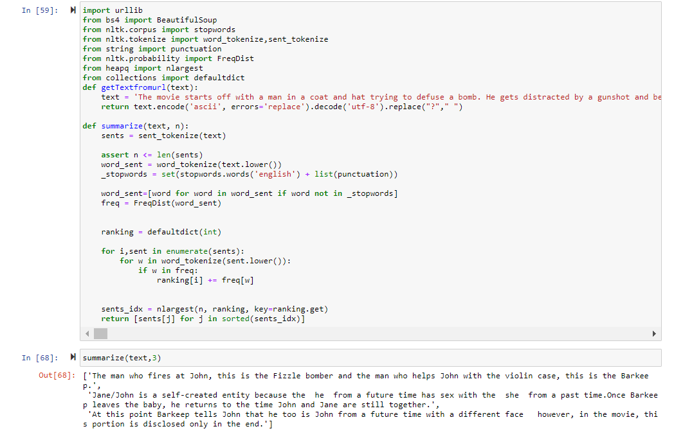
Rulebased Model

Slide 25
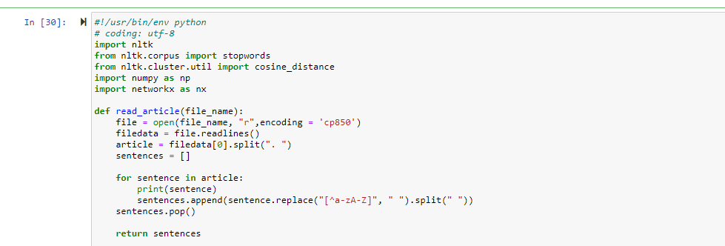
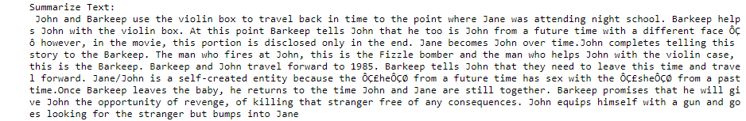
Textrank Model

Slide 26
Comparison of outputs
Standard input text length : 5940
Models | Method | Output(word count)
Pegasus (xsum) | Abstractive | 96
Pegasus(Large) | Extractive | 711
Pegasus(reddit-tifu) | Abstractive | 174
Gensim | Extractive | Ratio : 0.2=1545 0.3=2298
Rule Based | Extractive | Depends on sentences
Text Rank | Extractive | Input Top-3= 490

Slide 27
Preprocessing
Stopwords Removal
Contraction mapping
Text Cleaning
Remove ‘s
Remove “”
Remove (Text-Between)
Tokenization
Sentence Tokenization
Word Tokenization

Slide 28
REFERENCES
J.N.Madhuri,Ganesh Kumar.R “Extractive Text Summarization Using Sentence Ranking,”Institute of Electrical and Electronics Engineers (IEEE),2019.
Siya Sadashiv Naik, Manisha Naik Gaonkar,” Extractive Text Summarization by Feature based sentence extraction using rule based,”IEEE International Conference On Recent Trends in Electronics Information & Communication Technology (RTEICT),2017.
Aakanksha Sharaff, Amit Siddharth Khaire, Dimple Sharma,”Analyzing fuzzy based approach for extractive text summarization,”International Conference on Intelligent Computing and Control Systems (ICICCS 2019).
Kaiz Merchant, Yash Pande ,” NLP Based Latent Semantic Analysis for Legal Text Summarization,”IEEE,2018.
Abu Kaisar Mohammad Masum, Sheikh Abujar, Md Ashraful Islam Talukder, AKM Shahariar Azad Rabby, Syed Akhter Hossain,” Abstractive method of text summarization with sequence to sequence RNNs”,ICCCNT,2019.
16

Slide 29
Thank You

